Slide 1
AVL Tree
atjahyanto@gmail.com

Slide 2
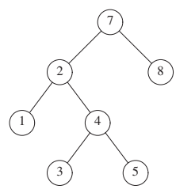
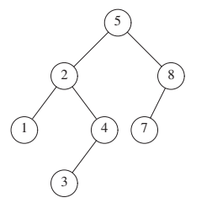
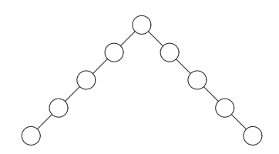
AVL tree (Adelson-Velsky and Landis tree)
Sebuah self-balancing binary search tree yang menyeimbangkan dirinya sendiri
Menjaga keseimbangannya dengan memastikan bahwa ketinggian subpohon kiri dan kanannya berbeda paling banyak satu.
Bukan AVL Tree
Bukan AVL Tree
AVL Tree

Slide 3
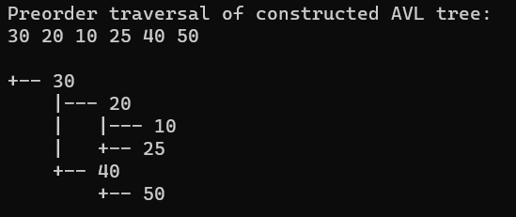
AVL Tree
class Node {
int key, height;
Node left, right;
public Node(int key) {
this.key = key;
this.height = 1;
this.left = null;
this.right = null;
}
}
public class AVLTree {
Node root;
int height(Node node) {
if (node == null)
return 0;
return node.height;
}
int balanceFactor(Node node) {
if (node == null)
return 0;
return height(node.left) - height(node.right);
}
Node rotateRight(Node y) {
Node x = y.left;
Node T2 = x.right;
x.right = y;
y.left = T2;
y.height = Math.max(height(y.left), height(y.right)) + 1;
x.height = Math.max(height(x.left), height(x.right)) + 1;
return x;
}
Node rotateLeft(Node x) {
Node y = x.right;
Node T2 = y.left;
y.left = x;
x.right = T2;
x.height = Math.max(height(x.left), height(x.right)) + 1;
y.height = Math.max(height(y.left), height(y.right)) + 1;
return y;
}
Node insert(Node node, int key) {
if (node == null)
return new Node(key);
if (key < node.key)
node.left = insert(node.left, key);
else if (key > node.key)
node.right = insert(node.right, key);
else
return node; // No duplicate keys allowed
node.height = 1 + Math.max(height(node.left), height(node.right));
int balance = balanceFactor(node);
// Left Left case
if (balance > 1 && key < node.left.key)
return rotateRight(node);
// Right Right case
if (balance < -1 && key > node.right.key)
return rotateLeft(node);
// Left Right case
if (balance > 1 && key > node.left.key) {
node.left = rotateLeft(node.left);
return rotateRight(node);
}
// Right Left case
if (balance < -1 && key < node.right.key) {
node.right = rotateRight(node.right);
return rotateLeft(node);
}
return node;
}
void preOrder(Node node) {
if (node != null) {
System.out.print(node.key + " ");
preOrder(node.left);
preOrder(node.right);
}
}
void displayTree(Node root, String prefix, boolean isLeft)
{
if (root != null) {
System.out.println(prefix + (isLeft ? "|--- " : "+-- ") + root.key);
displayTree(root.left, prefix + (isLeft ? "| " : " "), true);
displayTree(root.right, prefix + (isLeft ? "| " : " "), false);
}
}
void displayTree()
{
System.out.println("\n");
displayTree(root, "", false);
}
void insert_array(int A[])
{
for (int i=0; i<A.length; i++)
{
root = insert(root, A[i]);
}
}
void demo_insert_array(int A[])
{
for (int i=0; i<A.length; i++)
{
root = insert(root, A[i]);
displayTree();
}
}
public static void main(String[] args) {
AVLTree tree = new AVLTree();
int A[] = {10, 20, 30, 40, 50, 25};
tree.demo_insert_array(A);
System.out.println("Preorder traversal of constructed AVL tree:");
tree.preOrder(tree.root);
tree.displayTree();
}
}

